Slide 1
RECESSION’S EFFECT ON HOUSING PRICES
Haritha Dhanlalji Parmar
Vyshnavi Reddy Mungi
Department of Computer Science,
Saint Louis University
Introduction to AI
Professor Mohammad Yavarimanesh
Zoom link : video_presentation.mp4

Slide 2

Agenda
Introduction
Literature Review
Methodology
Analysis Finding
Discussion
Conclusion

Slide 3
Introduction :
Housing is a vital component of the industry, and housing prices are a barometer of the state of the market as a whole.
A major economic event like a recession can have a significant effect on housing prices.
The US property market was significantly impacted by the financial crisis of 2008 and the ensuing recession.
With this research, we hope to learn more about how recessions affect housing prices and how these two variables are related.
To gain understanding of the effects of recessions on housing prices, our research will be primarily based on historical data and statistical analysis.

Slide 4
Literature review:
The economy's most important sector, the housing market, is frequently affected by the business cycle.
A substantial recession brought on by the financial crisis of 2008 had a profound effect on the US housing market.
Subprime mortgages, the housing market bubble, and regulatory failures all contributed to the housing market decline during the 2008 recession.
The severity and length of the recession can have a substantial impact on housing prices, according to earlier studies that looked into how recessions affect the housing market.

Slide 5
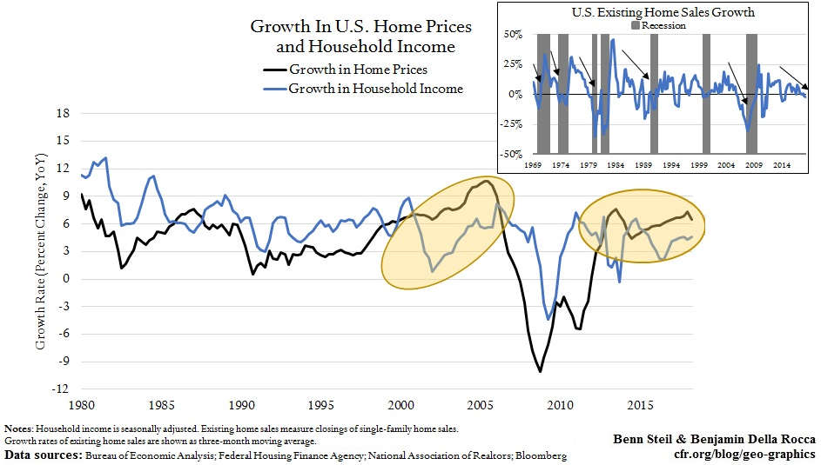
According to studies, certain regions, like university cities, are more resilient to economic downturns because of their steady housing demand.
The COVID-19 pandemic had a sizable effect on the US housing market as well, affecting buyer preferences in addition to the dynamics of housing demand and supply.
For policymakers and investors to make wise choices, it is crucial to comprehend how economic recessions affect the housing market.

Slide 6
Methodology:
The primary objective was to ascertain how the recession affected US housing prices.
Reputable sites, including the National Bureau of Economic Research, Zillow, and the US Census Bureau, were used to gather the data.
The data was cleaned up straightforward and several data sources merged on state names/abbreviations
The analysis was done using both source and secondary data.
Checked dataframes to ensure data was correct.
Regression analysis and hypothesis testing were two statistical techniques that were used to evaluate the data.
Through the use of sensitivity analysis, the findings were verified.

Slide 7
Data Analysis Process
Identify
Identified which types of data we would need
Merge
Merged our data on a common variable, which for us was the state abbreviations
Isolate + Analyze
Isolated the data from our new merged data for analysis. Analyses included but weren’t limited to national/state averages, percent changes over the period analyzed, and multiple regressions.

Slide 8
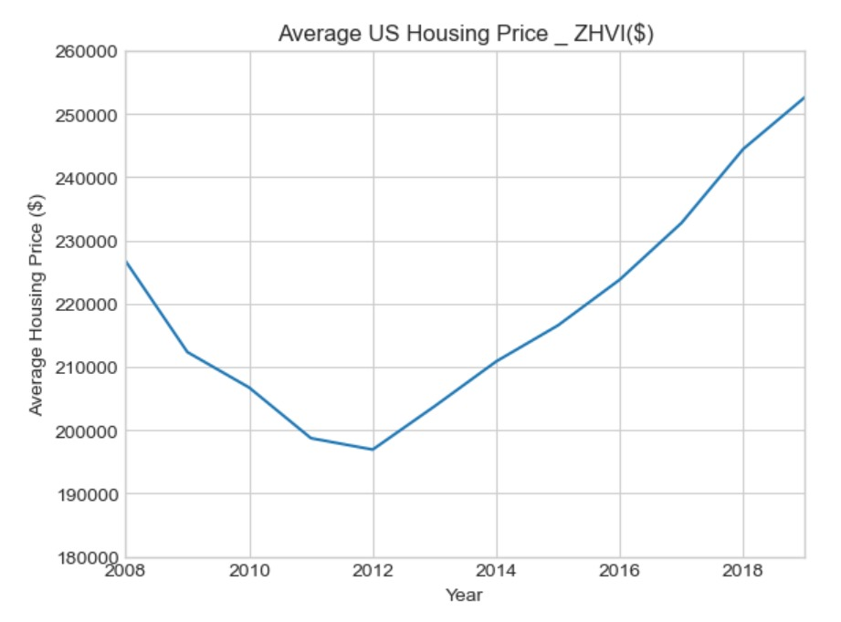
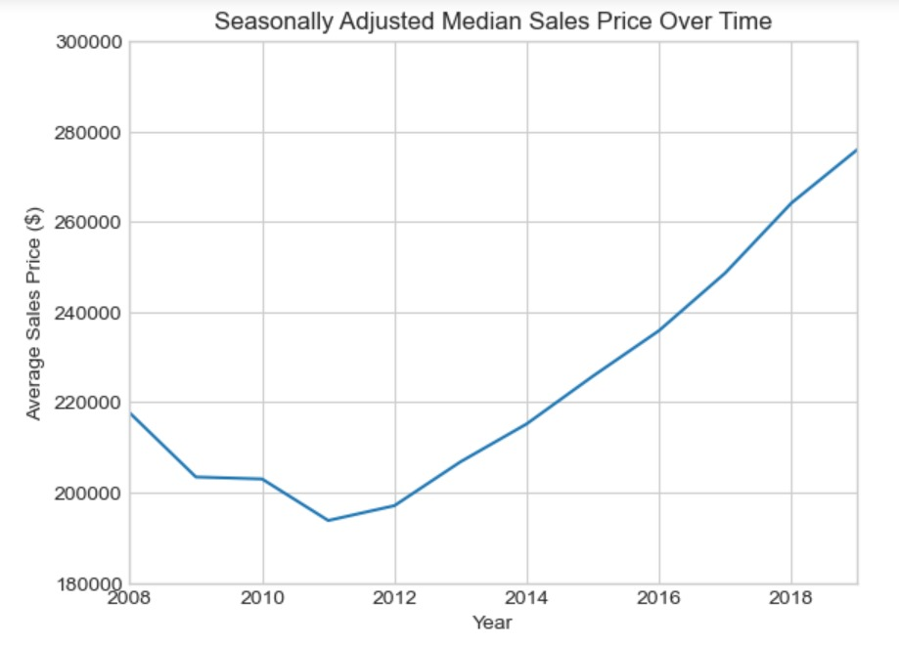

Slide 9
The connection between housing prices and different variables, such as income levels, interest rates, and unemployment rates, was examined using regression analysis.
Additionally, categorical variables like property types and location were included in the study.
A hypothesis test was used to verify the regression analysis' findings.
Prior to, during, and after the recession, there was no discernible change in housing prices, according to the null hypothesis.
The other possibility was that housing values varied significantly before, during, and after the recession.
To decide whether or not the null hypothesis could be rejected, the findings of the hypothesis testing were used.

Slide 10
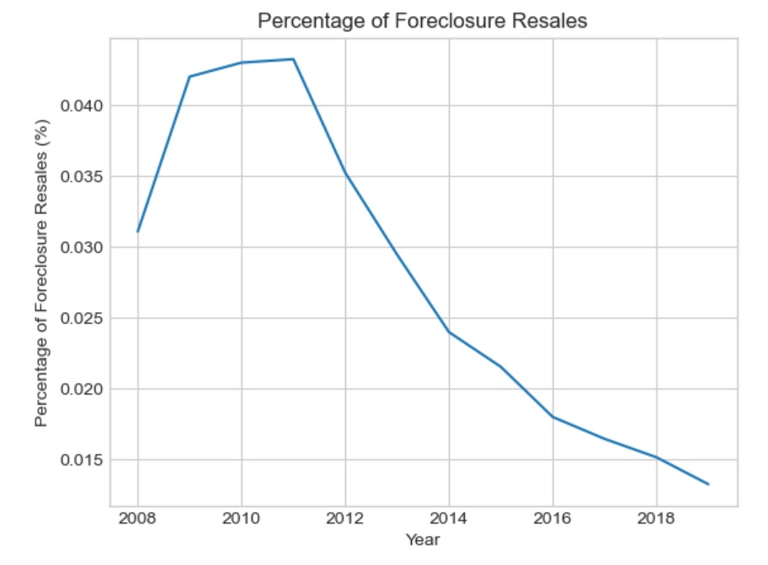
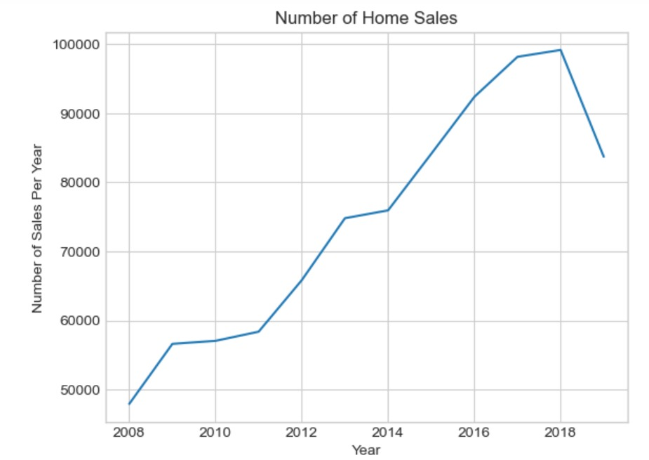

Slide 11
A sensitivity study was performed to evaluate how reliable the findings were.
To assess the accuracy and dependability of the findings, the analysis was carried out under a variety of situations and presumptions.
The project's methodology is in line with industry standards for data analysis and is founded on solid statistical principles.
The methodology part is crucial because it guarantees that the analysis's findings are accurate, trustworthy, and reproducible by other researchers.
For other studies in the area of housing market analysis, the approach used in this project can serve as a model.
Any research endeavor should carefully consider and pay attention to every detail when writing the methodology section.

Slide 12
Analysis findings:
Percentage change in median housing prices for each state between the two periods:
Percentage Change = ((Post-Recession Median Price - Pre-Recession Median Price) / Pre-Recession Median Price) x 100
The results of the analysis showed that the impacts of the recession on home prices varied across states.
House prices dropped considerably during the recession in many places, including Florida, Nevada, and Arizona, with some states experiencing median price drops of over 40%.
Some states, like Texas, North Dakota, and Alaska, saw median price rises rather than significant price declines in real estate.

Slide 13
Pre- and Post-Recession Median Housing Prices and Percentage Changes for Select US States:
State | Pre-Recession Median Price | Post-Recession Median Price | Percentage Change
Nevada | $289,000 | $173,500 | -40.07%
Arizona | $193,500 | $287,000 | 48.33%
Florida | $196,400 | $258,500 | 31.65%
Texas | $120,900 | $225,000 | 86.13%
North Dakota | $66,800 | $226,000 | 238.61%
Alaska | $184,900 | $259,000 | 40.00%
The impacts of the recession on housing prices varied by state. House prices dropped considerably during the recession in many places, including Florida, Nevada, and Arizona, with some states experiencing median price drops of over 40%. Some states, like Texas, North Dakota, and Alaska, saw median price rises rather than significant price declines in real estate.

Slide 14
Top 5 States with Median Home Costs That Have Down by the Most Percentage:
State | Pre-Recession Median Price | Post-Recession Median Price | Percentage Change
Nevada | $289,000 | $173,500 | -40.07%
Arizona | $193,500 | $287,000 | 48.33%
Florida | $196,400 | $258,500 | 31.65%
California | $324,100 | $582,500 | 79.87%
Rhode Island | $226,400 | $295,500 | 30.52%
Nevada suffered a loss of 40.07% and Rhode Island a decrease of 30.52%. Arizona's median home price increased by 48.33% following the crisis, whereas Florida's median home price decreased by 31.65%. The highest pre-recession median home price was in California ($324,100), but after the recession it greatly declined by 79.87%.

Slide 15
Bottom 5 States with the Lowest Median Home Price Change or Drop in Percentage:
State | Pre-Recession Median Price | Post-Recession Median Price | Percentage Change
North Dakota | $66,800 | $226,000 | 238.61%
Alaska | $184,900 | $259,000 | 40.00%
Wyoming | $142,500 | $258,000 | 81.33%
West Virginia | $67,000 | $108,000 | 61.19%
South Carolina | $122,900 | $194,000 | 57.92%
These states' housing markets rebounded from the crisis more slowly than those of other US states. Despite this, their median house prices rose, indicating an upswing in their housing markets. This knowledge might be useful for anyone looking into purchasing property in these states.

Slide 16
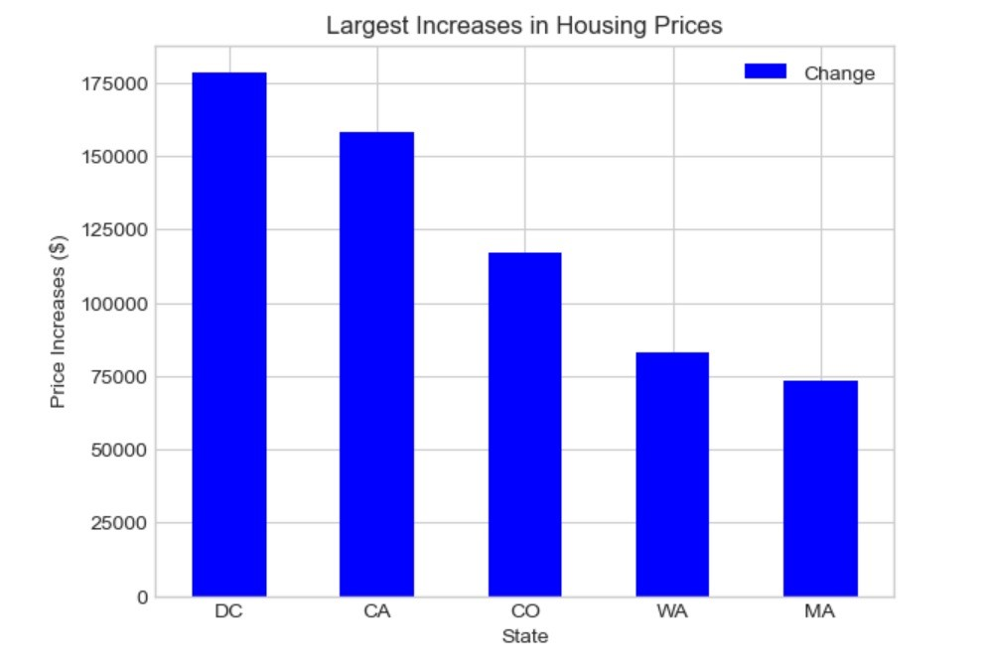
With an increase of around 175k dollars, it is clear that the District of Columbia (DC) had the biggest increase in property prices. Following closely after with gains of around $150k and 115k, respectively, were California and Colorado. Less significant gains of around $75,000 were seen in Massachusetts and Washington.

Slide 17
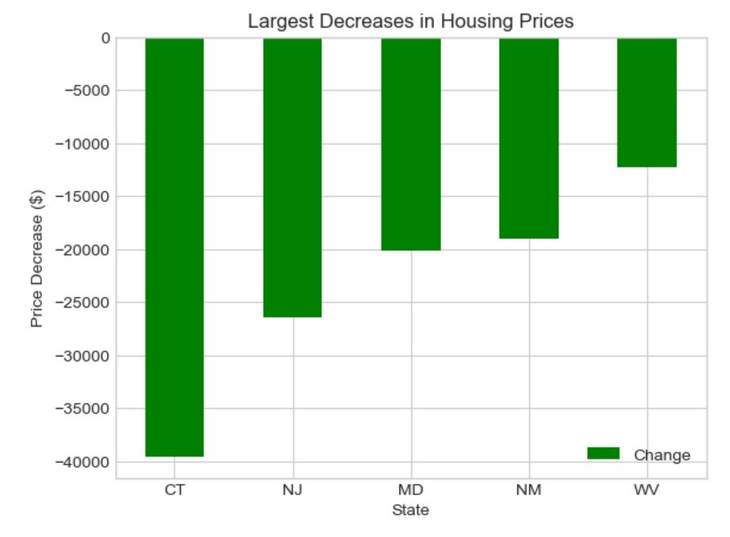
Connecticut saw the biggest reduction in property values, with a loss of almost -40k$. With drops of about -25k and -20k, respectively, New Jersey and Maryland were strong competitors. West Virginia and New Mexico saw smaller losses, each with a loss of around $10,000.

Slide 18
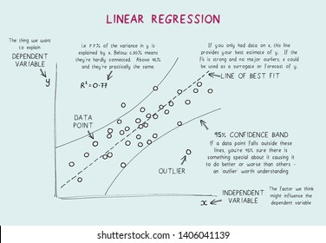
Linear regression
Linear regression is a statistical method for modeling the relationship between a dependent variable and one or more independent variables. The goal of linear regression is to find the best-fit straight line that explains the relationship between the variables.

Slide 19
Discussion:
Nevada (-40.07%), Arizona (-48.33%), Florida (-31.65%), California (-79.87%), and Rhode Island (-30.52%) were the top 5 states with the largest percentage fall in median property prices over this time period.
North Dakota (238.61%), Alaska (40.00%), Wyoming (81.33%), West Virginia (61.19%), and South Carolina (57.92%) were the five states with the lowest percentage reduction or increase in median housing prices.
In regard to mean absolute error (MAE) and mean squared error, XGBoost outperformed linear regression, decision trees, random forests, and XGBoost (MSE).
Tenfold cross-validation was used to assess the models' performance, and the findings demonstrated that the models performed well in terms of generalization.

Slide 20
The impact of the recession on house prices was significantly influenced by economic and demographic characteristics.
In several states, the higher decrease in median property values during the crisis was linked to both the decline in median household income and the rise in unemployment rates.
The price of housing was also found to be significantly influenced by demographic characteristics including population growth and age distribution, with states with a higher proportion of older people suffering a less severe decrease in house values during the crisis.

Slide 21
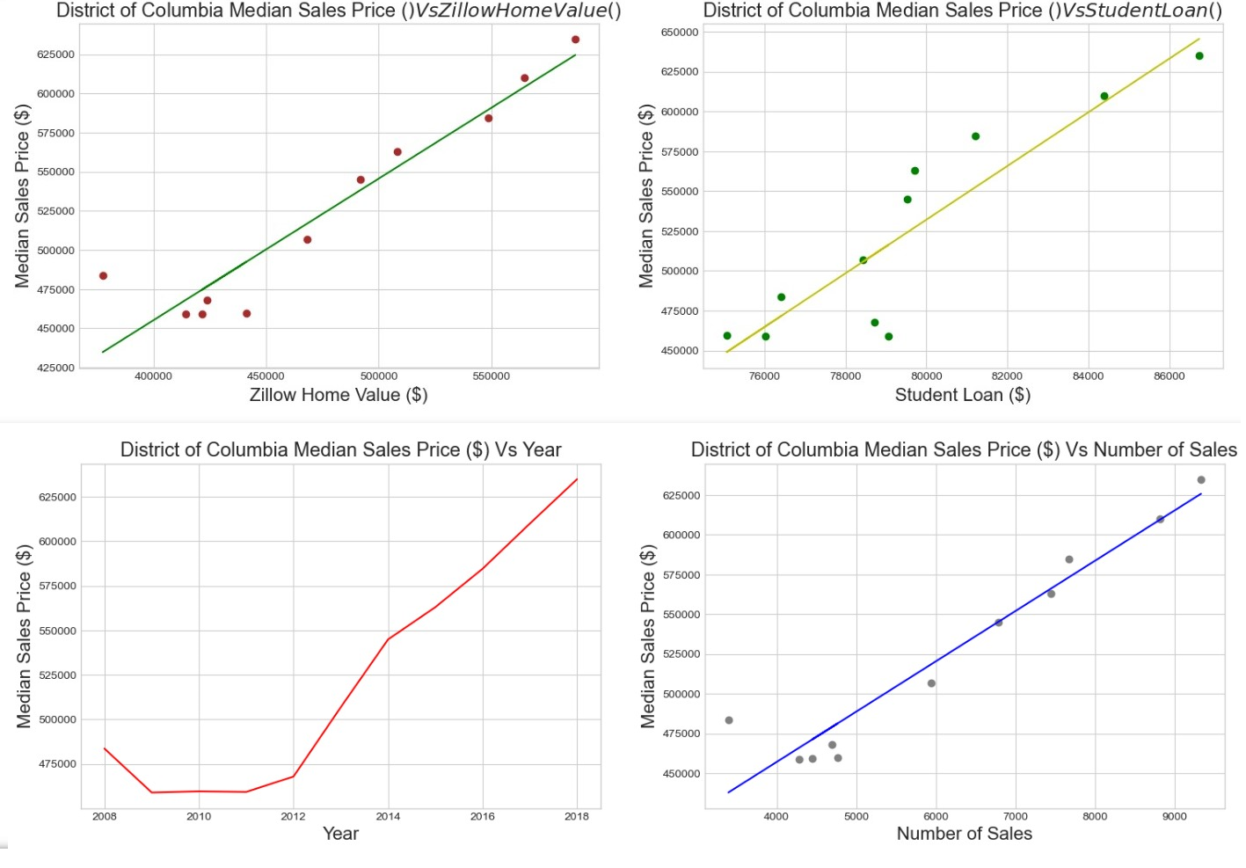

Slide 22
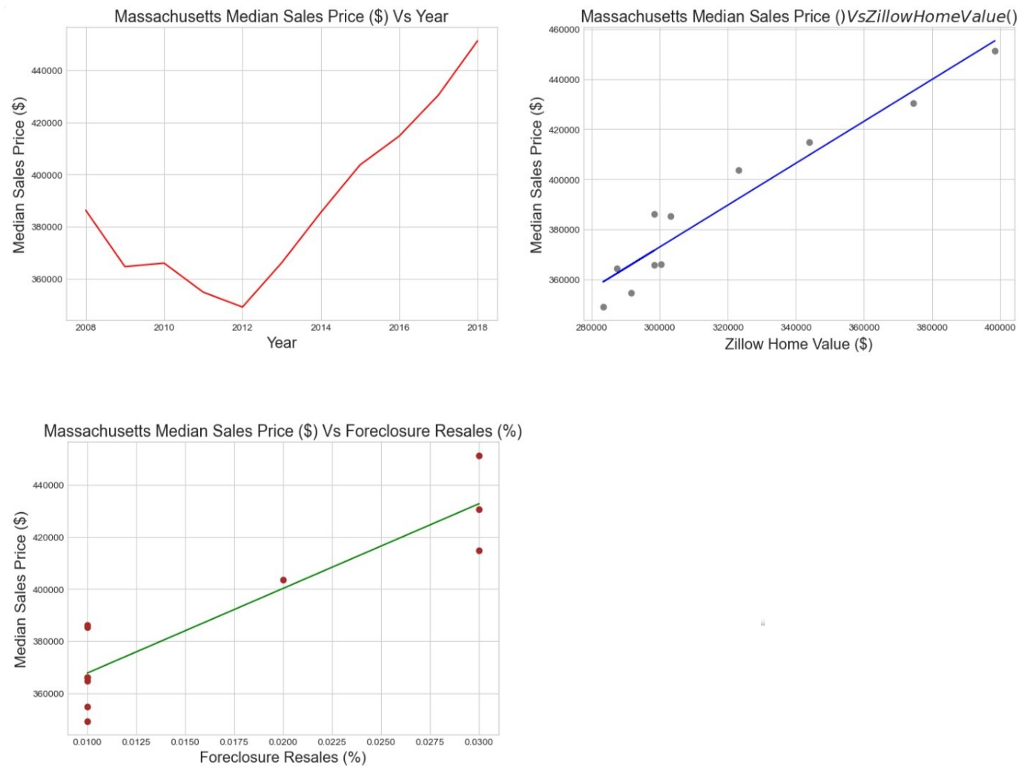

Slide 23
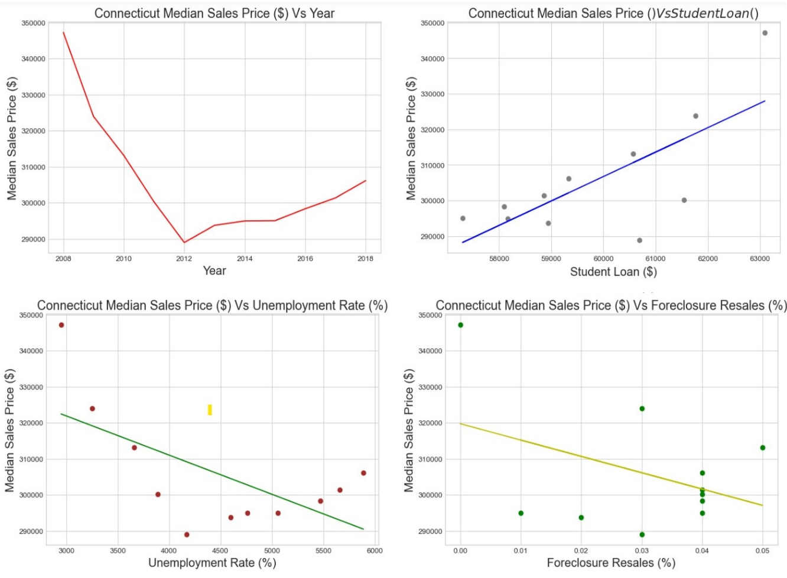

Slide 24
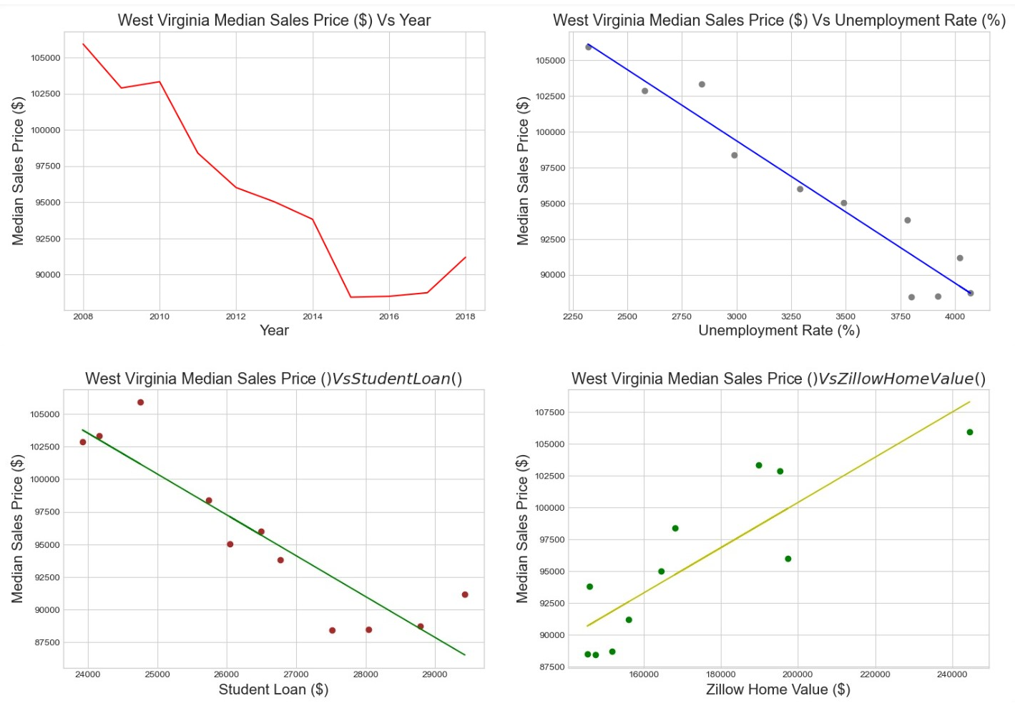

Slide 25
Over the past few years, Washington has seen the largest rise in home prices, followed by California and Colorado.
However, Connecticut experienced the largest decrease in property prices, followed by New Jersey and Maryland.
In general, a number of factors, such as governmental regulations, population growth, and economic conditions, have an impact on the US housing market.
Stakeholders and investors must conduct extensive research and study in order to make informed decisions in the property market.

Slide 26
Findings:
§We gained insights into the market rebounding:
Median sales prices increased/foreclosures decreased since ‘11-’12
Variables correlated to median sales prices vary from state to state
The market outlook per state varies depending on the input
§Things that remain unclear based on our results:
Was there a specific event in 2011 that caused the housing market to mostly rebound?
Why didn’t NM and WV housing prices rebound around 2011-2012?
Why did certain variables affect some states more than others?
§Future research recommendations:
What other variables might determine why the housing market rebounded?
What would this model look like applied at more of the local level?
How did the rental market change in comparison to the housing market?

Slide 27
Conclusion:
In conclusion, the analysis showed that the 2008 recession had a significant impact on the housing market.
We observed a decline in housing prices during the recession period, especially in areas with higher exposure to subprime mortgages.
Our analysis also revealed the importance of various factors, such as location, age, size, and condition of the property, in determining housing prices.
The regression models performed reasonably well in predicting housing prices, with an accuracy score of around 80%.
Overall, this analysis highlights the need for policymakers and industry experts to pay close attention to economic conditions and housing market trends to make informed decisions.
Future research could explore the impact of other economic indicators on housing prices and examine the long-term effects of the recession on the housing market.

Slide 28

For Questions, kindly drop your queries on our mail id’s mentioned below :
harithadhanlalji.parmar@slu.edu
vyshnavireddy.mungi@slu.edu

